Slide 1

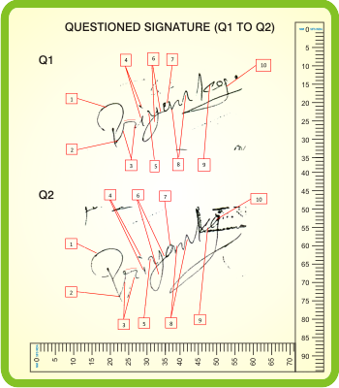
Epoch 6: Signature Verification
FruitPunch.AI/Code
17.09.2019
M. Alican Noyan

Slide 3
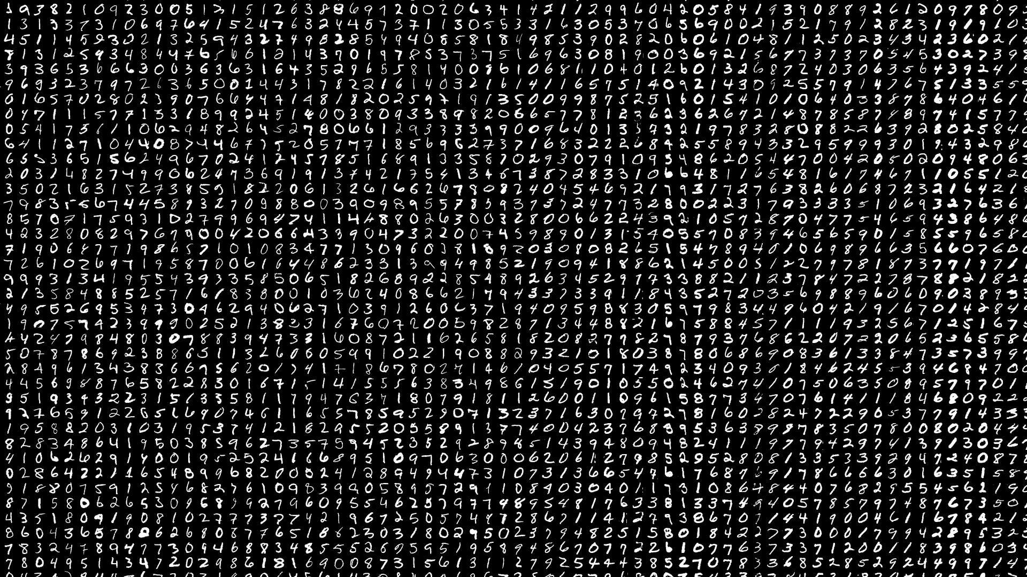
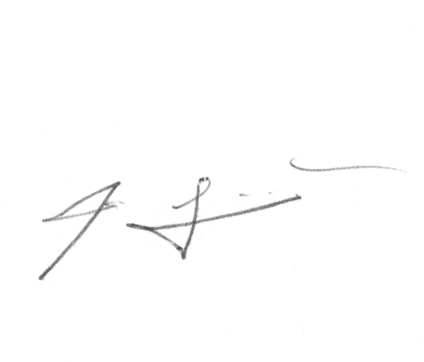
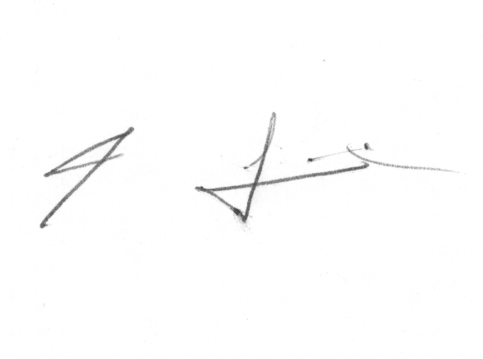
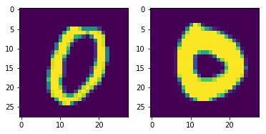
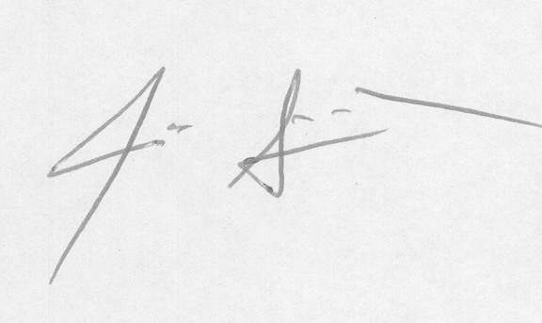
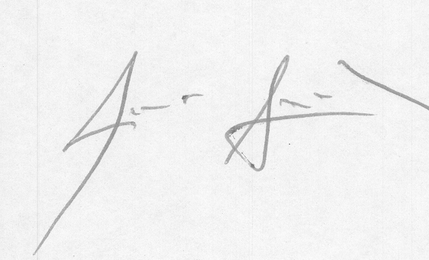
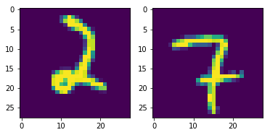
Signature dataset
Alternative dataset
cedar.buffalo.edu/NIJ/data/
There are two folders
1. full_forg: Contains 1320 forgery signatures (24 forgeries for each of 55 writers).
2. full_org: Contains 1320 genuine signatures (24 genuines for each of 55 writers).

